Slide 1

ILLINOIS INSTITUTE OF TECHNOLOGY (IIT)
Laboratory Safety Training – GHS Classification: SDS, Labels and Pictograms

Slide 2
Purpose
The purpose of this course is to make Faculty, Staff, Students and any other individuals who will be performing tasks with chemicals at Illinois Institute of Technology (IIT), understand the basic requirement of the Hazard Communication System pertaining to SDS, labeling and pictograms.
Having readily available information on the hazardous properties of chemicals, and recommended control measures, allows the production, transport, use and disposal of chemicals to be managed safely.
The sound management of chemicals includes systems through which chemical hazards are identified and communicated to all who are potentially exposed.
GHS classification and labeling systems address potential exposure to chemicals in all types of use

Slide 3
CHEMICAL HAZARD INFORMATION
A Material is Considered Hazardous If:
It is specifically listed in the law, 29CFR Part 1910, Subpart Z, Toxic and Hazardous Substances (the Z list);
It is assigned a Threshold Limit Value (TLV) by the American Conference of Governmental Industrial Hygienists, Inc (ACGIH)
It is determined to be cancer causing, corrosive, toxic, an irritant, a sensitizer or has damaging effects on specific body organs

Slide 4




CHEMICAL HAZARD INFORMATION
KNOW THE PROPERTIES OF AGENTS YOU DEAL WITH BY REVIEWING ITS GHS CLASSIFICATION:
Toxicity.
Flammability.
Reactivity/Incompatibilities.
Corrosive.
Unstable.
Radioactive.
Clean Up Procedures.

Slide 5
CHEMICAL HAZARD INFORMATION
What is the purpose of an MSDS/SDS?
An MSDS (material Safety Data Sheet) or an SDS (Safety Data Sheet) is available to inform material users or first responders of:
the material's physical properties or fast-acting health effects that make it dangerous to handle.
the level of protective gear you need.
the first aid treatment to be provided when there is an exposure to the hazard.
the preplanning needed for safely handling spills, fires, and day-to-day operations.
how to respond to accidents.
For the remainder of this document we will refer to these sheets as SDS

Slide 6
CHEMICAL HAZARD INFORMATION
What is GHS?
The GHS is an acronym for The Globally Harmonized System of Classification and Labeling of Chemicals.
The GHS is a system for standardizing and harmonizing the classification and labeling of chemicals. It is a logical and comprehensive approach to:
Defining health, physical and environmental hazards of chemicals.
Creating classification processes that use available data on chemicals for comparison with the defined hazard criteria.
Communicating hazard information, as well as protective measures, on labels and Safety Data Sheets (SDS).

Slide 7
The Globally Harmonized System of Classification and Labelling of Chemicals
OSHA has adopted the Globally Harmonized System (GHS).
The Hazard Communication Standard (HCS) requires chemical manufacturers, distributors, or importers to provide Safety Data Sheets (SDSs) (formerly known as Material Safety Data Sheets (MSDS)) to communicate the hazards of hazardous chemical products. As of June 1, 2015, the HCS will require new SDSs to be in a uniform format, and include the section numbers, the headings, and associated information listed on the next slide.

Slide 8
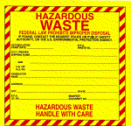

SAFETY DATA SHEETS
WHAT INFORMATION IS REQUIRED IN THE SDS:
Section 1, Identification includes product identifier; manufacturer or distributor name, address, phone number; emergency phone number; recommended use; restrictions on use.
Section 2, Hazard(s) identification includes all hazards regarding the chemical; required label elements.
Section 3, Composition/information on ingredients includes information on chemical ingredients; trade secret claims.
Section 4, First-aid measures includes important symptoms/ effects, acute, delayed; required treatment.

Slide 9
SAFETY DATA SHEETS
WHAT INFORMATION IS REQUIRED IN THE SDS:
(Continued)
Section 5, Fire-fighting measures lists suitable extinguishing techniques, equipment; chemical hazards from fire.
Section 6, Accidental release measures lists emergency procedures; protective equipment; proper methods of containment and cleanup.
Section 7, Handling and storage lists precautions for safe handling and storage, including incompatibilities.
Section 8, Exposure controls/personal protection lists OSHA's Permissible Exposure Limits (PELs); Threshold Limit Values (TLVs); appropriate engineering controls; personal protective equipment (PPE).

Slide 10
SAFETY DATA SHEETS
WHAT INFORMATION IS REQUIRED IN THE SDS:
(Continued)
Section 9, Physical and chemical properties lists the chemical's characteristics.
Section 10, Stability and reactivity lists chemical stability and possibility of hazardous reactions.
Section 11, Toxicological information includes routes of exposure; related symptoms, acute and chronic effects; numerical measures of toxicity.
Section 16, Other information, includes the date of preparation or last revision.

Slide 11
SAFETY DATA SHEETS
(Continued)
WHAT INFORMATION CAN BE INCLUDED IN THE SDS:
Section 12, Ecological information*
Section 13, Disposal considerations*
Section 14, Transport information*
Section 15, Regulatory information*
*Note: Since other Agencies regulate this information, OSHA will not be enforcing Sections 12 through 15(29 CFR 1910.1200(g)(2)).

Slide 12


SAFETY DATA SHEETS
(Continued)
TRADE SECRETS:
Information Withheld From a SDS Must Be Provided During an Emergency or at The Request of a Physician. The User of The Information Must Agree to Keep The Information Confidential. The Chemical Manufacturer Must Provide the Information Immediately Upon Request During Emergencies.

Slide 13
SAFETY DATA SHEETS
(Continued)
Who is responsible for reviewing SDS?
Anyone using a material should review the SDS first.
Supervisors are responsible for ensuring that employees and students have access to SDS.
If there is an accident involving an exposure to hazardous materials, provide a copy of the SDS to the health care provider.

Slide 14
Labels

Slide 15
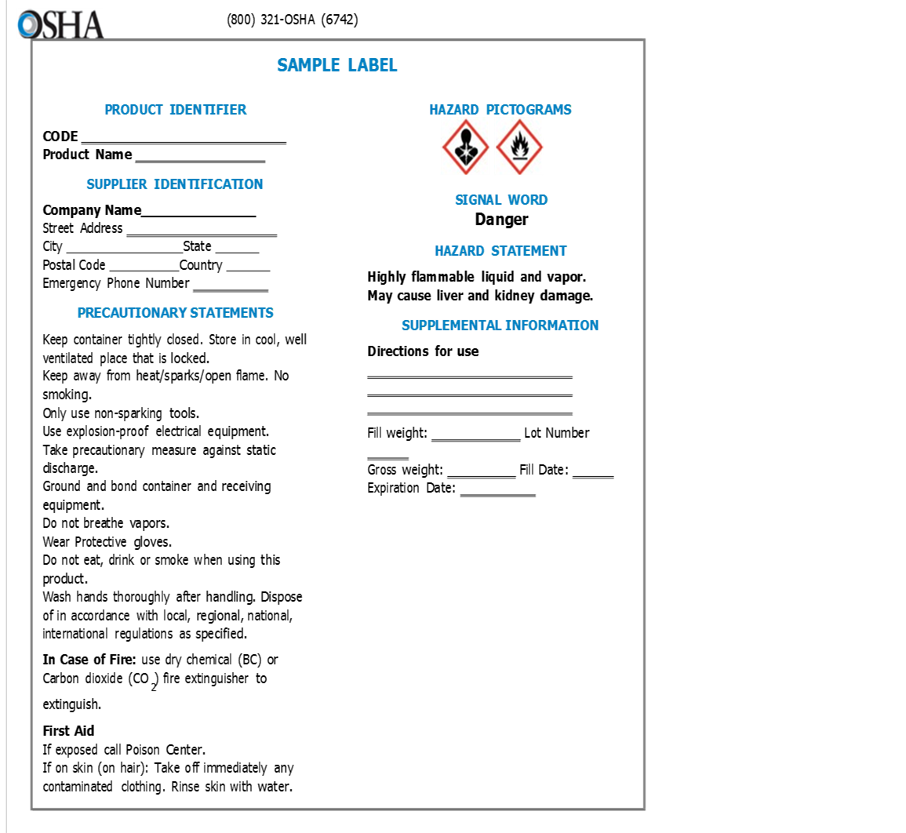
Labels
(Continued)

Slide 16
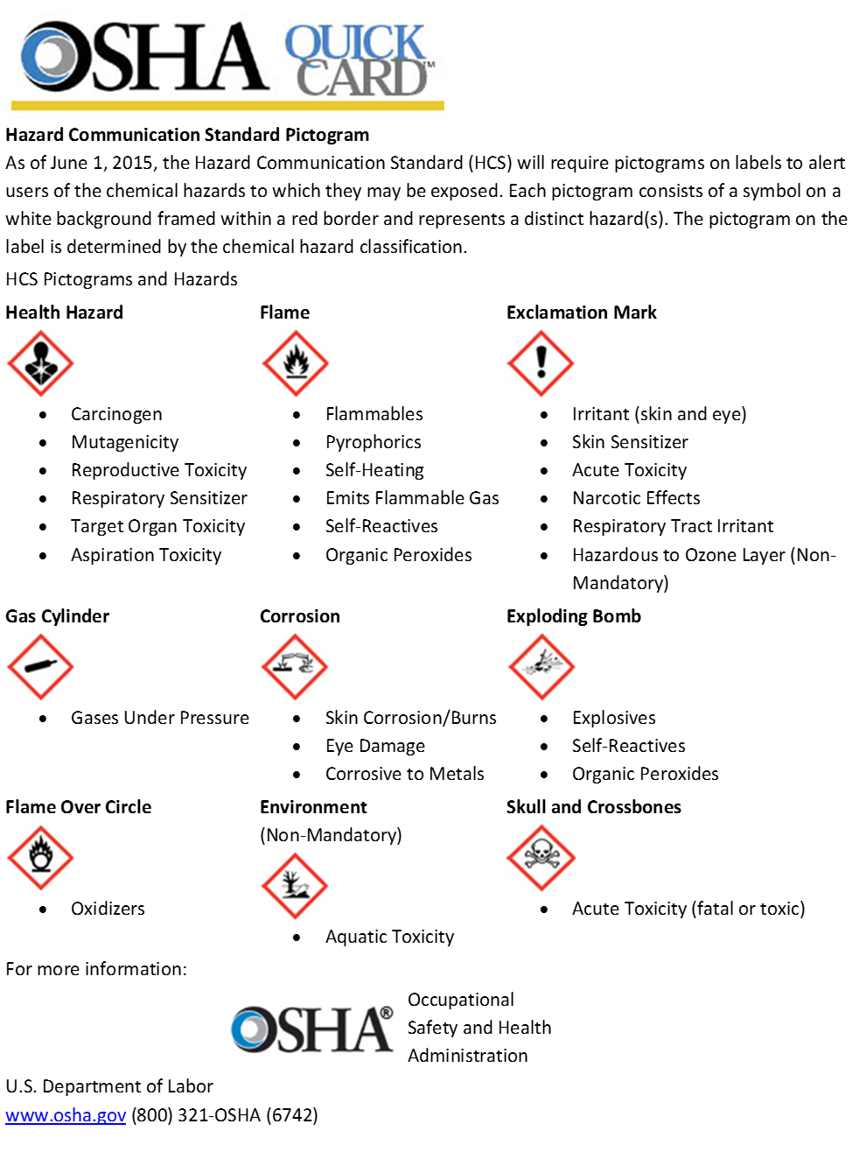
Pictograms

Slide 17
CHEMICAL HAZARD INFORMATION
Remember
Before using a Chemical:
Read the SDS.
Understand the SDS.
Follow the SDS.
Read the label.
Understand what the label is telling you.
Follow instructions on the label.
If you are not sure ask someone knowledgeable.

Slide 18
The preceding course material is mostly excerpts from the Occupational Safety and Health Administration (OSHA) document “A Guide to: The Globally Harmonized System of Classification and Labelling of Chemicals (GHS)” located at http://www.osha.gov/dsg/hazcom/ghs.html#4.2. If you would like more detail on GHS please refer to this document.

Slide 19
If you need further safety assistance, contact the Department of Environmental Health and Safety at (312) 567-3084

